Slide 1

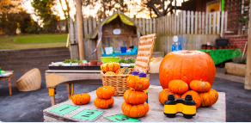
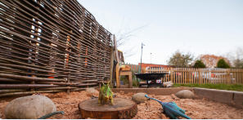

What can I expect from Goodway if my child has Special Educational Needs?
We will make sure your child is safe and happy
Have open and honest communication
Appropriate and effective teaching and learning
A Partnership Approach

Slide 2
Definition of Special Educational Needs
Children have special educational needs if they have a learning difficulty which calls for special educational provision to be made for them.
Children have a learning difficulty if they:
a) Have a significantly greater difficulty in learning than the majority of children of the same age
b) Have a disability which prevents, or hinders them from making use of educational facilities of a kind generally provided for children of the same age in schools within the area of the local education authority
c) Are under compulsory school age and fall within the definition at (a) or (b) above or would so do if special educational provision was not made for them.
SEN CoP 1:3

Slide 3
What should I do if I have concerns about my child?
What will happen if the nursery have concerns about my child?
If you have any concerns speak to your child’s keyworker, or make an appointment to see the SENCO. Our SENCo is Lucy Collins. If we have any concerns we will speak to you as soon as possible.
The SENCO and Keyworker will assess your child’s needs through a range of strategies
Once your child’s individual needs have been identified the SENCO may need to contact specialised services - these can include Speech and Language therapists (SALT), The Communication and Autism Team (CAT), or an Educational Psychologist (EP). We will always ask for your permission first.
The SENCO and the nursery team will monitor your child’s progress and will meet with you regularly to discuss how your child is getting on.
You will be kept fully informed of all the support your child is receiving and you will be involved at every stage of the process.
Together with the SENCo and any specialised services, you will contribute to agreeing targets that will support your child’s needs.

Slide 4

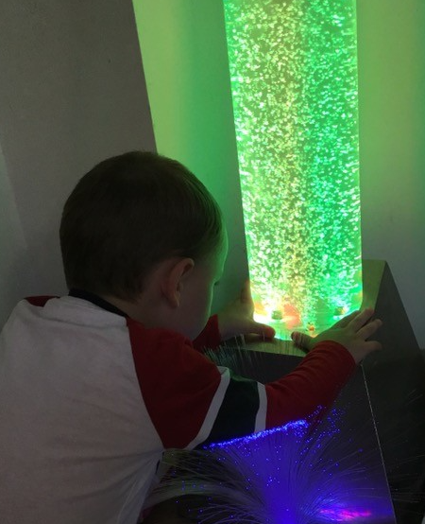
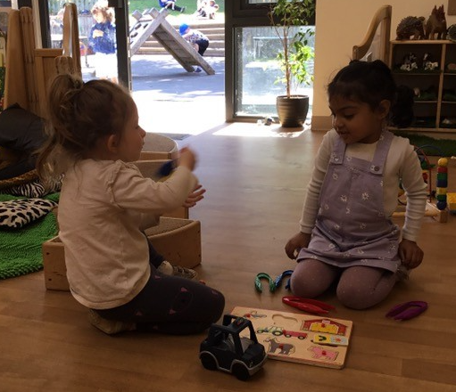
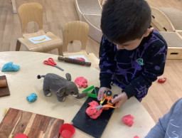
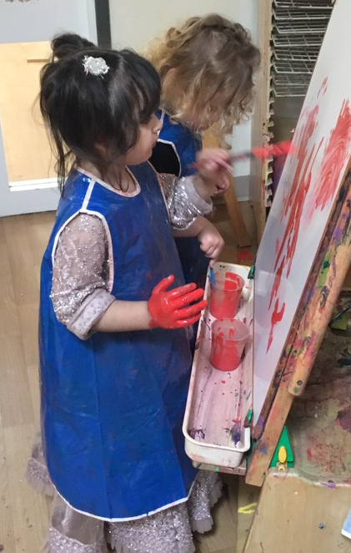
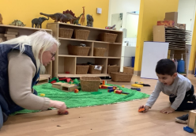
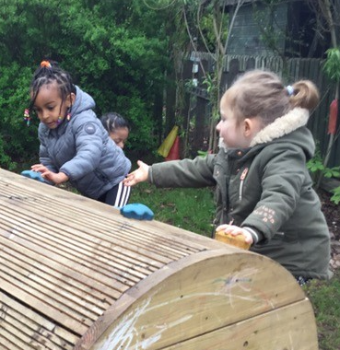
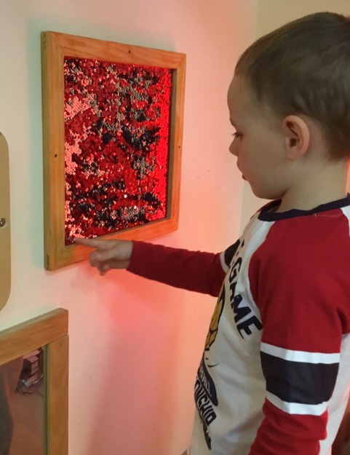
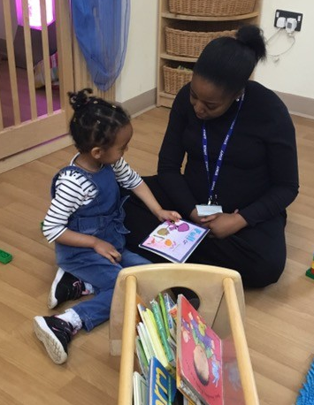
Before any intervention, we ensure that we have given the children time to settle, feel safe and happy, and build positive relationships.
We spend time Getting To Know each child.
Stand aside for a while and leave room for learning, observe carefully what children do, and then, if you have understood well, perhaps teaching will be different from before.
Loris Malaguzzi

Slide 5
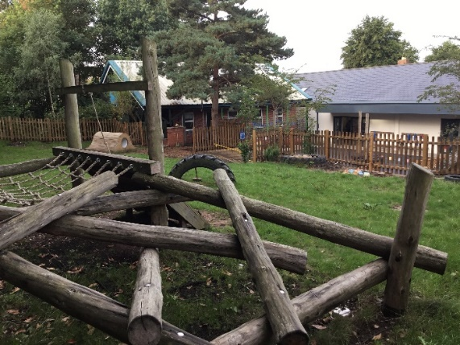
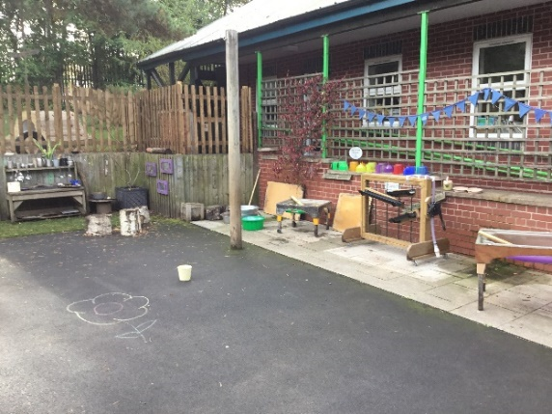
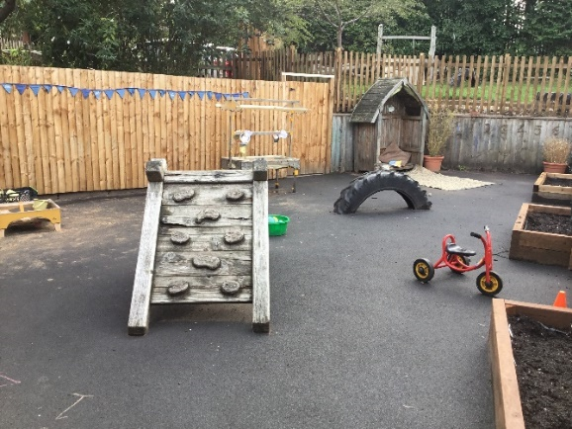
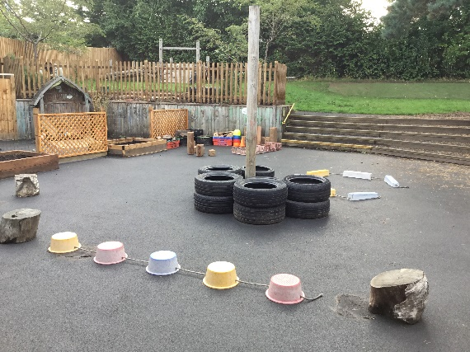
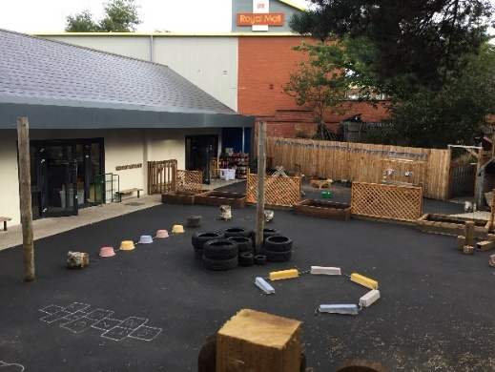
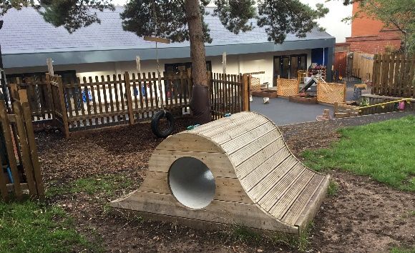
Outside Environment
The garden is a wonderful place for children to learn about the world around them.
For children with complex needs, this is important for sensory regulation, movement in different ways and experiencing different equipment.
Educators support children in different ways, depending on the needs of the child and their level of ability.

Slide 6
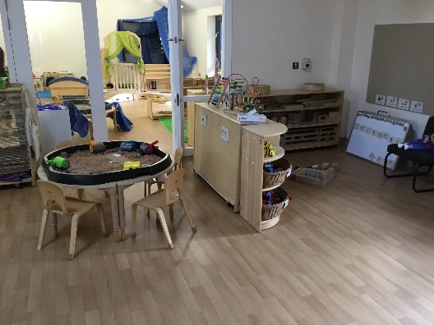
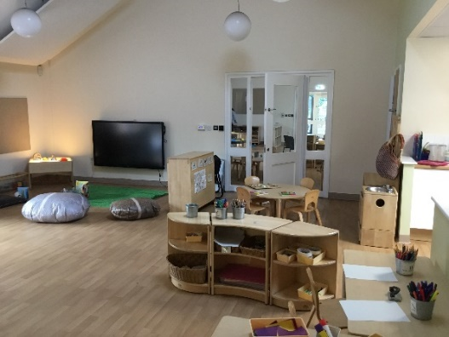
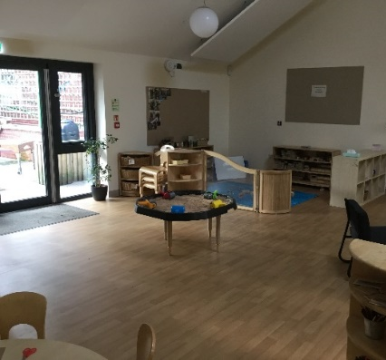
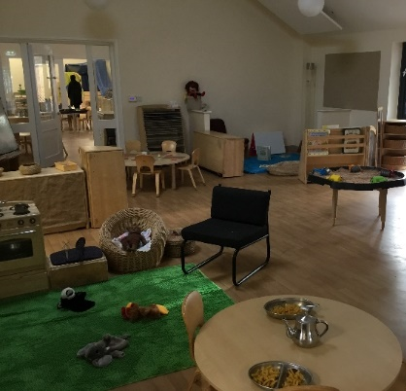
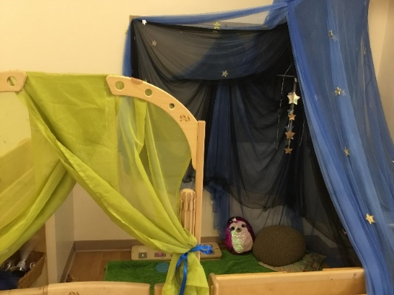
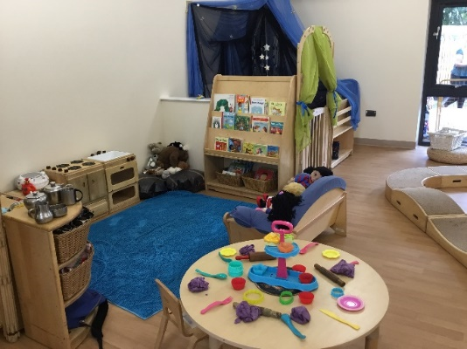
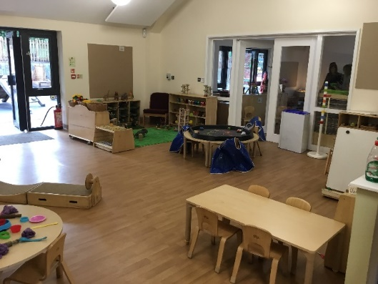
Inside Environment
There are 3 classrooms at nursery. 1 classroom is for 2 year olds and the other 2 are for 3 year olds. Each classroom has defined areas such as, construction, creative, sensory and role play. All resources are clearly labelled with communicate and print, or photos. The keyworker will work with the SENCo to identify individual support and interventions both inside and outside.

Slide 7
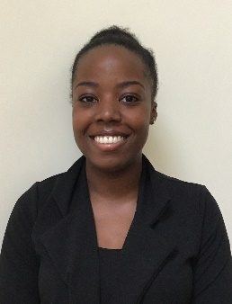
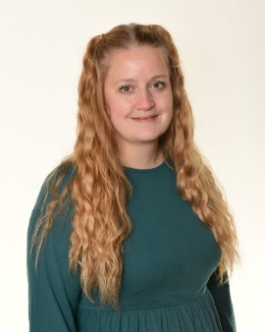
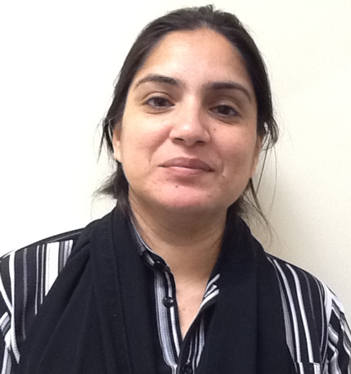
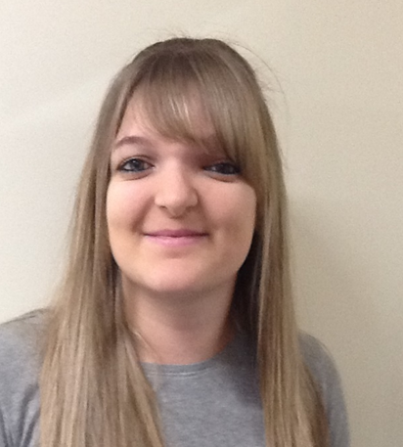
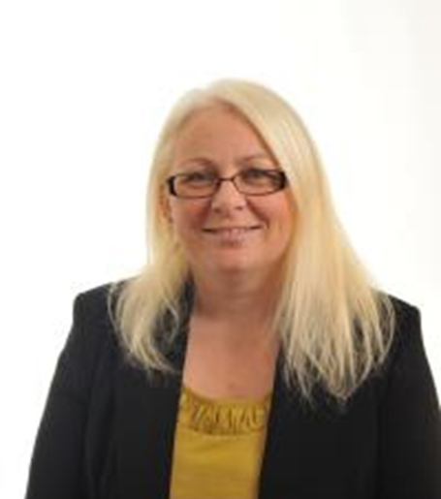
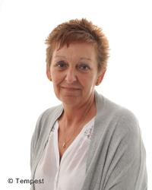
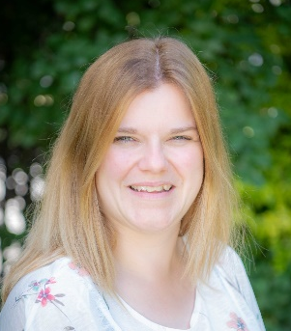
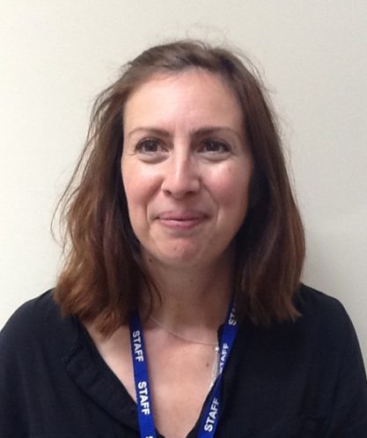
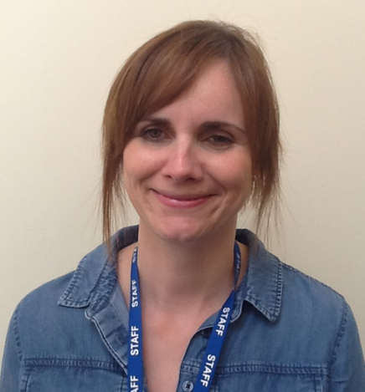

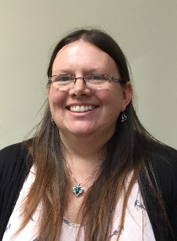
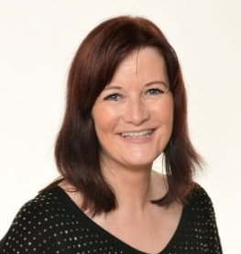
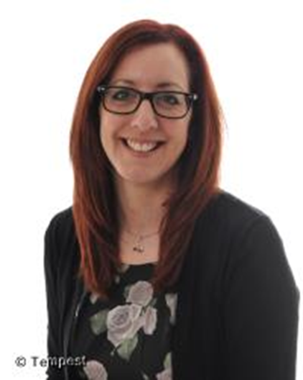
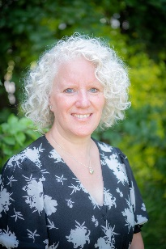
Our Team….
At Goodway, every child has a key worker to ensure their individual needs are met. You will have the opportunity to speak to your child’s key worker daily. These are photos of team.

Slide 8
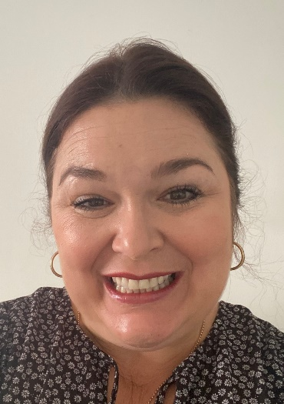
Appropriate and effective personalised teaching and learning
At Goodway Nursery School we are committed to supporting every child. To ensure we can do this effectively our team members attend a wide range of training and regularly seek advice from outside agencies and professionals in other settings.
The training that the nursery team receive is based on the individual needs of the children who attend. The SENCO, with the support of the Headteacher and Governors, ensures that training is up to date and is appropriate.
All of our educators are trained to use Makaton to support communication.
Lucy Collins
SENCo and Assistant Head
Sally Davies
Headteacher

Slide 9
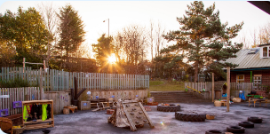
How we work
Step 1 Gather information from Parents/Carers
Home Visits/ settle visits
All about Me
Step 2 Develop our knowledge of the child
WellComm
Baseline Assessments (EYFS)
Step 3 Teaching and Learning, Targeted intervention
Continuous Provision – independent play, educator supported, visual timetables,
Targeted Support – 1:1 at times, language groups, Makaton, all keyworkers have photo cards
SENCO
Outreach Family Support
Educational Psychologist
CAT Team
Health Visitor
Occupational Therapy
This support is accessed at each step

Slide 10
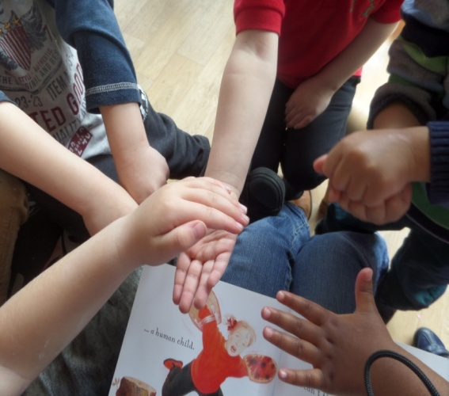
A Partnership Approach
Goodway Nursery School & CC works with outside agencies who can provide a specialised service, to ensure every child has their needs met. We will always talk to you if we feel that your child needs support from an outside agency and we will ask for your permission to involve them.
Educational Psychologist (EP)
Supports children who have social, mental or emotional needs, or other complex needs.
SENAR – Principal Officer (PO)
If your child has an Education and Health Care Plan (EHC) we will work closely with your principal officer.
Speech & Language Therapy Service (SALT) –Support for children with speech and language difficulties.
Communication & Autism Team (CAT)
Supports children, or young people who are being assessed for, or already have, a diagnosis of Autism or communication difficulties.
Occupational Therapy
Support for children or young people with physical/sensory issues which impact on their levels of independence and self care
Family Support Team
We have a Family Support drop in service every
Every Monday
9:30-11am
Health Visitor
Support for children with development checks, medical needs, including where medication is prescribed/required.

Slide 11
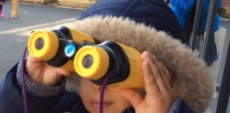

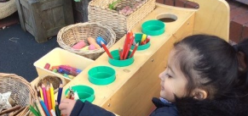
Graduated Response
Goodway Nursery School adopts the
Graduated Response
The Graduated Approach has Four Stages of action:
1. Assess - Goodway Assessments are:
Baseline
WellComm
Tapestry – online Learning Journey
2. Plan - This happens daily and weekly, in
whole staff meetings
3. Do - in a variety of ways
4. Review - monitor every 2 weeks for a 6
week period. After 6 weeks a
decision will be made whether the
child needs a SEN Support Plan,
referrals to different professionals or an
Education and Health Care Plan

Slide 12
Preparing for Adulthood
We prepare all of our SEND learners for adulthood from the earliest stages. The provision is personalised and focused on the aspirations of the young person and their parents.
The four areas of preparation for adulthood are:
Employment (including Higher Education)
Independent Living
Community Inclusion (including participation in society)
Health
Discussions with parents always encourage thinking about what the future might look like for their child at an early age. We promote a focus on outcomes that are transferable to the real world. We understand and acknowledge that all of our learners develop at different rates and we always use their personalised starting points in all preparation for adulthood and when setting individualised targets and provision.
For more information please follow this link:
https://www.ndti.org.uk/resources/preparing-for-adulthood-all-tools-resources

Slide 13

Useful Documents found on My Care in Birmingham
My Care In Birmingham
https://www.localofferbirmingham.co.uk/
https://birmingham.connecttosupport.org/s4s/WhereILive/Council?pageId=3859&lockLA=True
SEND Code of Practice
https://www.birmingham.gov.uk/info/50034/birminghams_local_offer_send/1421/special_educational_needs_code_of_practice
https://assets.publishing.service.gov.uk/government/uploads/system/uploads/attachment_data/file/398815/SEND_Code_of_Practice_January_2015.pdf
EHC pathway
https://www.birmingham.gov.uk/downloads/file/8190/ehc_pathway_revised_130815

Slide 14



Developing Local Provision (DLP)
We aim to provide:
A responsive and reliable point of contact for parents/carers to access professional advice and guidance about their child’s development and learning for parents and carers.
A professional development programme of training and information, connections with relevant professionals and access to a network of colleagues engaged in a learning community for staff in all settings.
A collaborative and positive partnership with all professionals to ensure child’s right to access high quality early education

Slide 15
Consultation with Parents
There was a consultation with parents at nursery in July 2024. Parents shared what they thought worked for their child and family and made suggestions:
Information Report – feedback was that it was clearly presented. Liked photos.
Really enjoyed attending the coffee mornings to talk to other parents and SENCo alongside visiting professionals- DLP, Children’s centre, SENSE, OT, SALT, CAT.
Parents valued the reviews with multi agency professionals which helped them to feel valued and included on their child’s learning journey.
Parents enjoyed visiting special school settings with their child’s keyworker.
Parents really enjoyed workshops each half term to see what and how their children learn at Nursery.
Parents really enjoyed virtual meetings with Occupational Therapy / SALT and nursery staff.

Slide 16
Consultation with Parents
Quotes from parents July 2024:
“Thank you so much for all the support X has received. I can really see a difference in his mood. He is a lot happier”.
“As a parent I am so grateful that my daughter got all the support. When she started she was self directed and dysregulated. Now she got the right support for now and her future. Thank you so much”.
“We feel that the Nursery has listened to our concerns and acted upon them”.
“Nursery has given me opportunities to speak with professionals who can help me and my child”.

Slide 17
Learning Walks
Every term the SEND Governor monitors provision via a Learning Walk. In the Autumn term, SEND was inspected as part of our Peer Review, with local schools. CAT have provided INSET to staff in May and June 2024 to develop our practice further to support learners needs, based on observations in class.
Strengths
Relationships with children – good listening and responding to children’s needs
Consistent use of Makaton – objects of reference were also used to support
Great selection of resources – both inside and outside
Purposeful and engaging activities led by educators
Transition procedures
Multi agency working
Areas to develop
Continue to embed Attention Bham strategies
Offer Sensory Circuits at different points of the day

